Slide 1

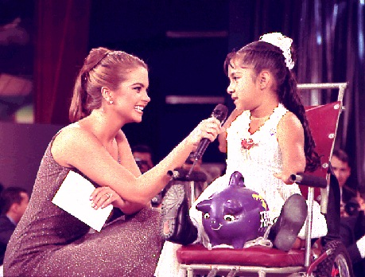
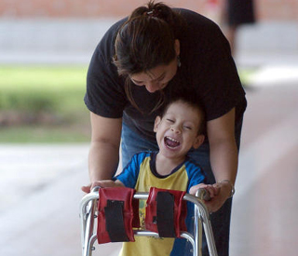
Solidarity, Rehabilitation, Love and Hope
2009

Slide 2

Birth

Slide 3
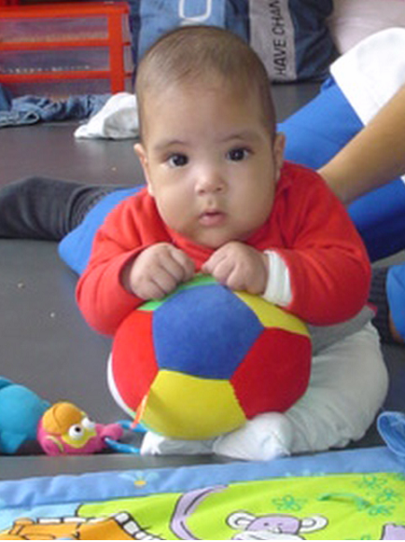
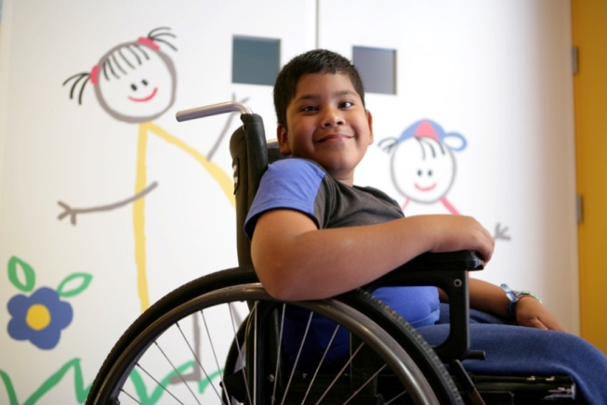
The Latinoamerican
Cruzade
Brasil
Chile
Costa Rica
Colombia
El Salvador
Guatemala
Honduras
México
Nicaragua
Panamá
Paraguay
Perú
Uruguay

Slide 4
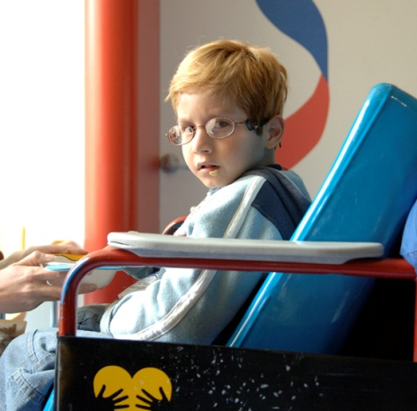
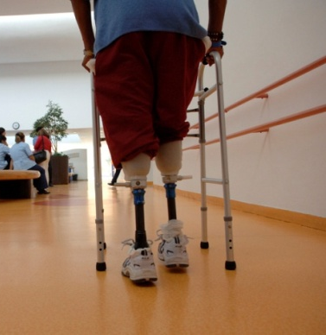
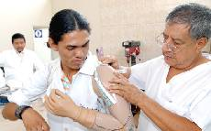
Our goal
400 thousand babies, children and young people
The WHO/OMS statistics, indicate that the world wide average disability incidence is 10%.
The Latinamerican population is closed to 400 million people, if we focus in the infant and young people phisical disability, we´ll find the hard reality of 400 thousand babies, children and young people with different capacities.
ORITEL, in our 13 countries/Teletones and over 82 rehabilitation centers, brings every year, medical assistance, love and hope up to 75.000 babies, children and young people.

Slide 5
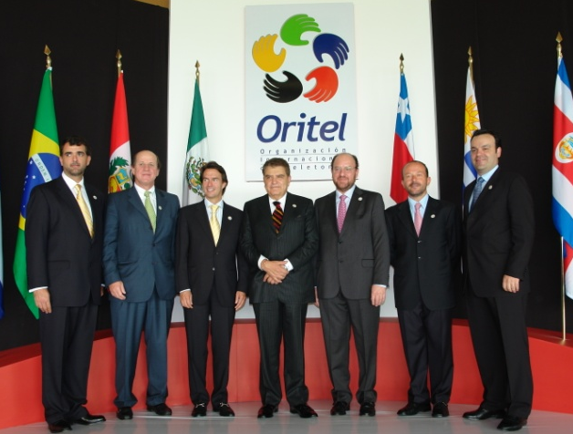
Organization
Honorary President, Mario Kreutzberger
Vice President, Alfredo Moreno, Chile
General Secretary, Eugenio Silva, Chile
Executive Committee
  Alfredo Moreno, Chairman of the Chilean Board
  Fernando Landeros, Chairman of the Mexican Board
  Rafael Stand, CEO Teleton Colombia
Medical Committee
  Brasil
  México
  Chile
Administration Committee
  Uruguay
  Nicaragua
  México
Marketing Committee
  Paraguay
  Guatemala
  Brasil

Slide 6
Achievement

Slide 7
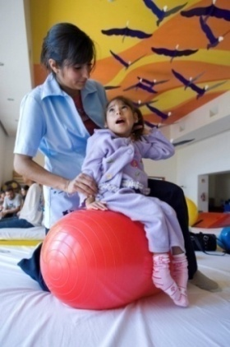
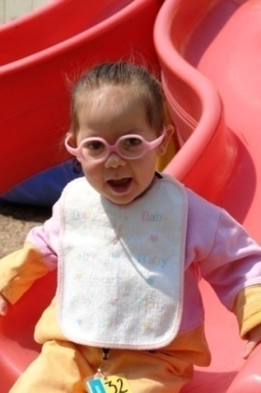
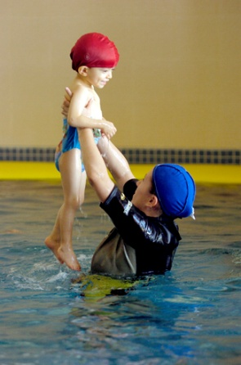
Objectives 2009 -2010
INSTITUTIONAL
To develop an organizational strenthening program, through the technical and financial support of IDB.
To revive countries that had been in recess and to expand the Teleton program to those countries where it doesn´t exist.
To position ORITEL in the health International organization framework.
To stablish an Internal Communications program in order to create fluid and participative channels.

Slide 8
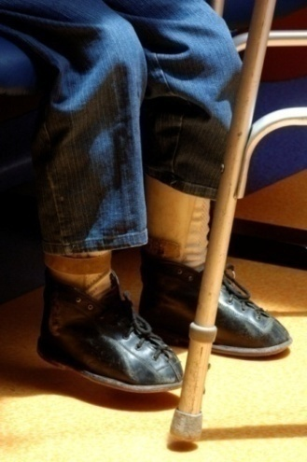
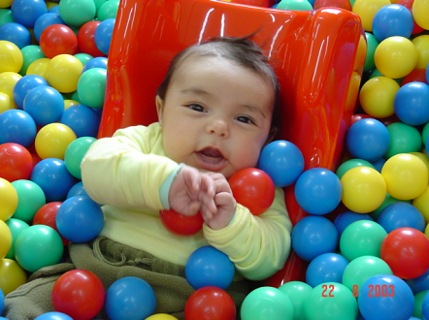
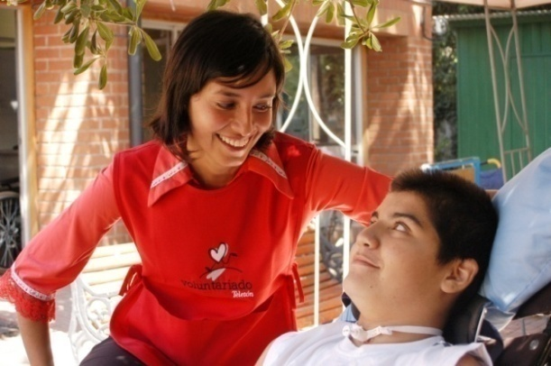
Objectives 2009 -2010
MEDICAL
To activate the medical exchange program, which will allow us to expand new techniques and knowledge to every country.
To develop an educational program, starting with the Orthesis & Prosthesis school.
To Start the “ITELO On Wheels Program”, assisting teleton countries by providing wheel chairs to all patients that require it.

Slide 9
Objectives 2009 -2010
ADMINISTRATION
To Systematize the statistic information model. (medical, fundraising, welfare, etc.)
To implement the WEE FIM benchmark ratio, in order to measure the functional improvement of our patients.
To generate alliances with our suppliers to achieve economy of scale.

Slide 10
Objectives 2009 -2010
MARKETING
To exhibit a regional campaign of “ Prevention “.
To assist all the teleton countries in the creation, development and production of their Teleton campaigns.
To generate a WEB digital marketing archive proyect.
To develop a fundraising program in order to finance all the institutional, medical, administrative and marketing initiatives.

Slide 11
Dreams

Slide 12
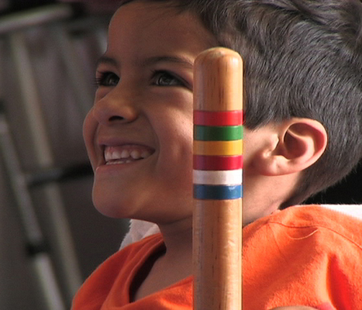
Solidarity, Rehabilitation, Love and Hope

